Slide 1
Pizza sale Data analysis
By Sohel mollick

Slide 2
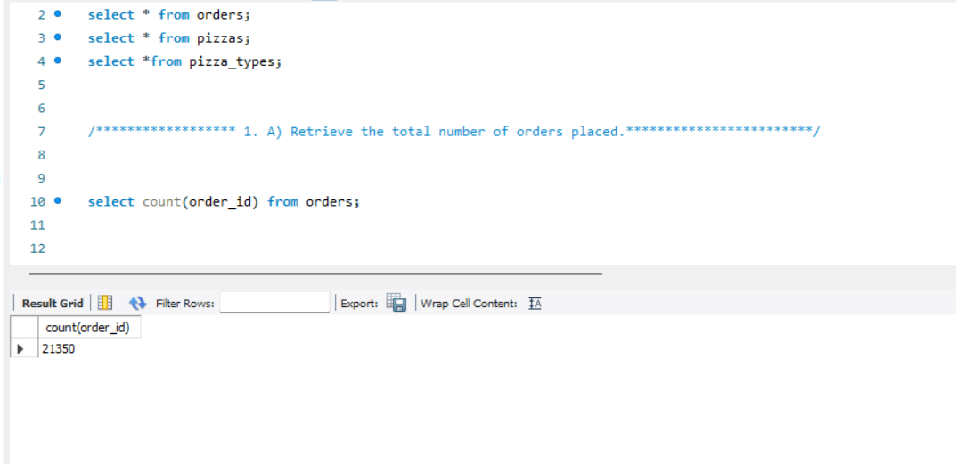
A.Retrieve the total number of orders placed.

Slide 3
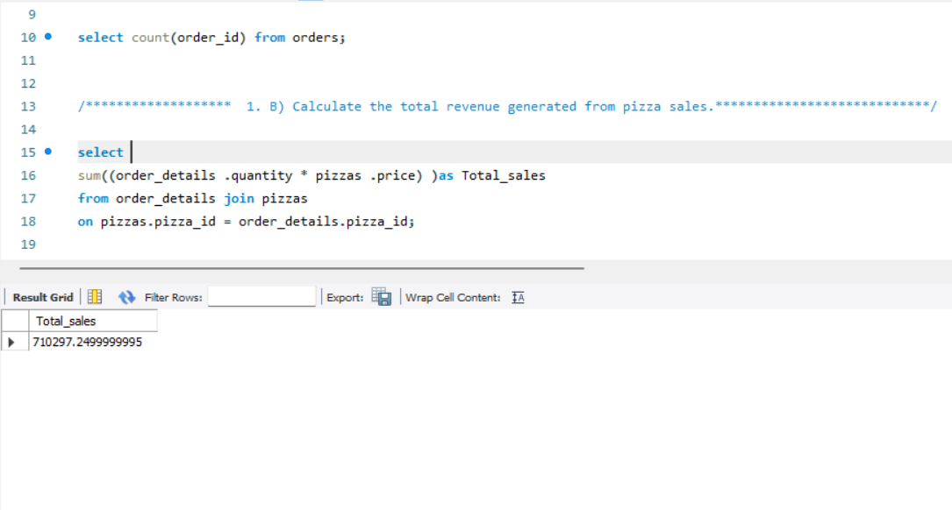
B.Calculate the total revenue generated from pizza sales.

Slide 4
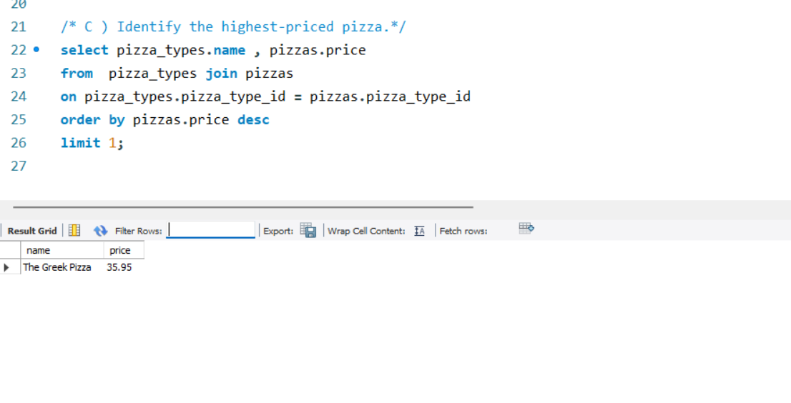
C.Identify the highest-priced pizza.

Slide 5
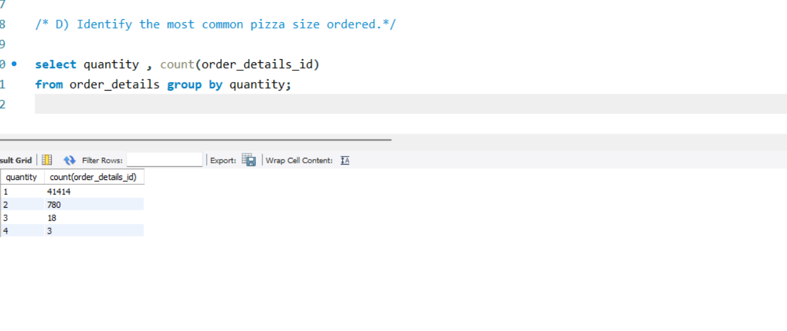
D.Identify the most common pizza size ordered.

Slide 6
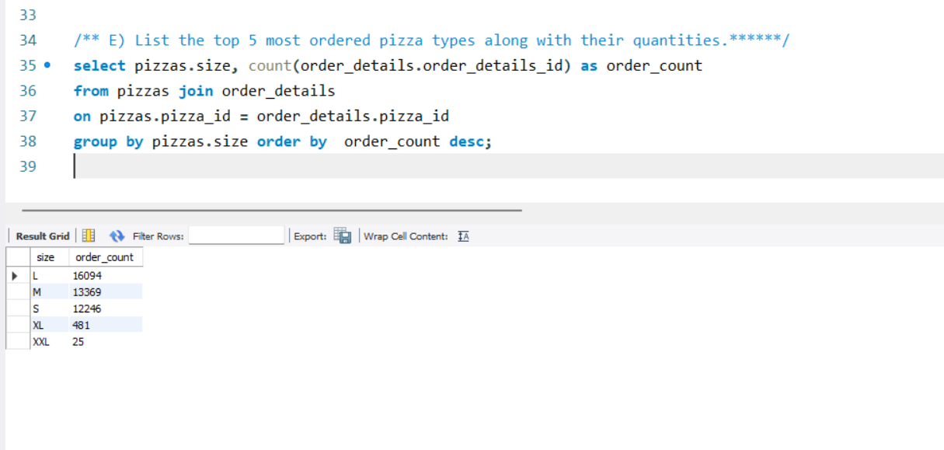
E.List the top 5 most ordered pizza types along with their quantities.

Slide 7
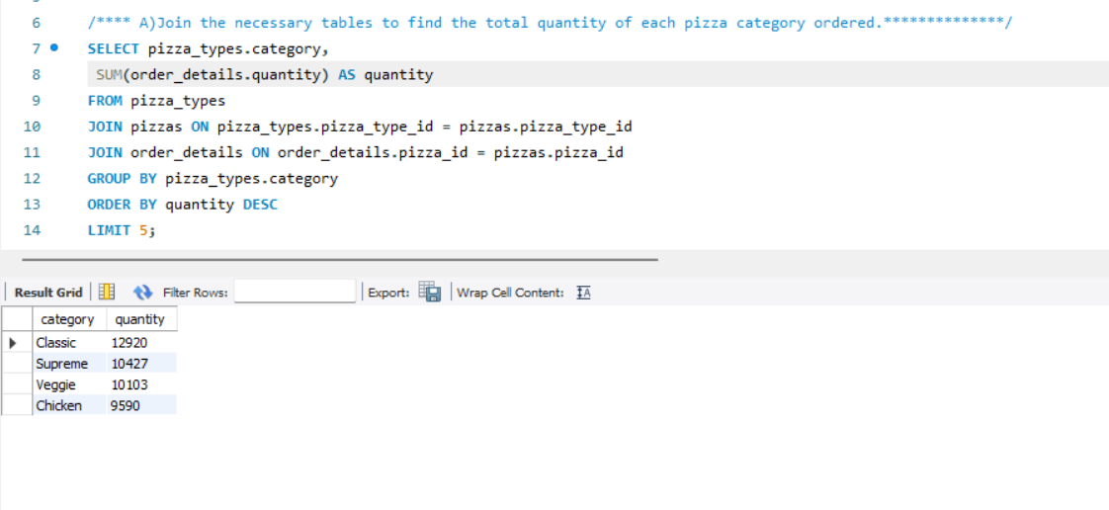
A.Join the necessary tables to find the total quantity of each pizza category ordered.

Slide 8
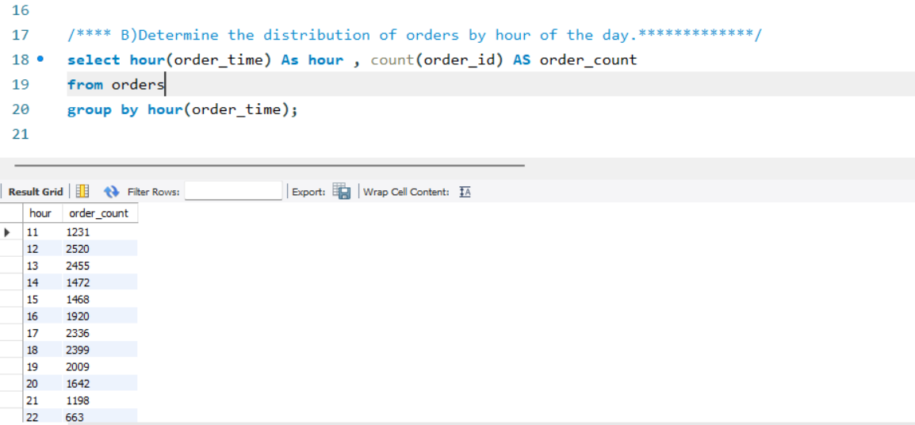
B.Determine the distribution of orders by hour of the day.

Slide 9
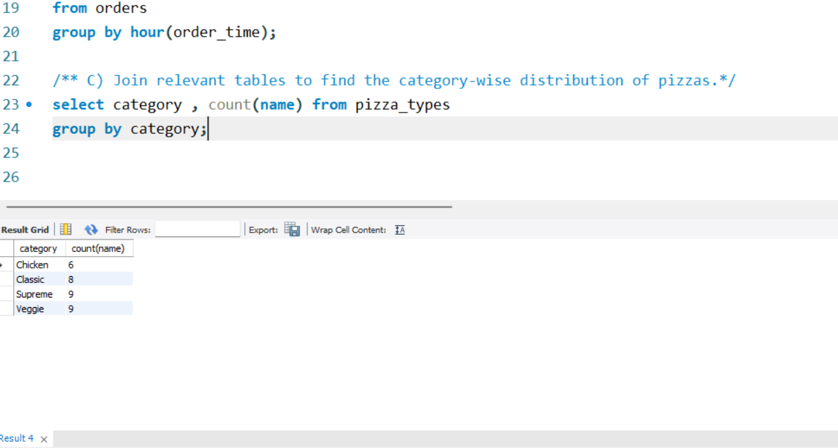
C. Join relevant tables to find the category-wise distribution of pizzas.

Slide 10
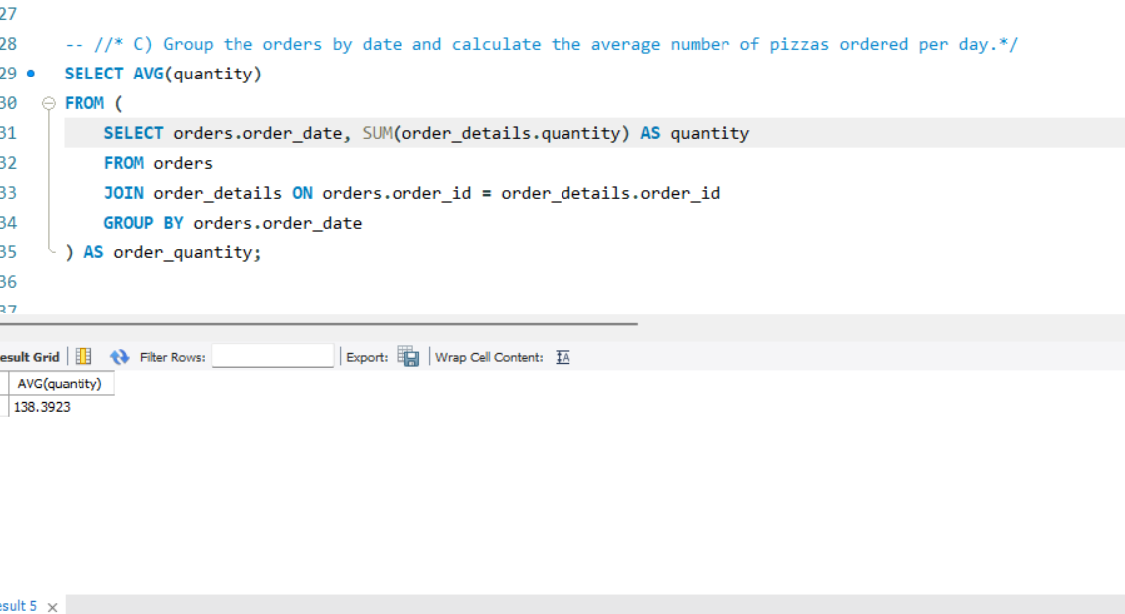
D. Group the orders by date and calculate the average number of pizzas ordered per day.

Slide 11
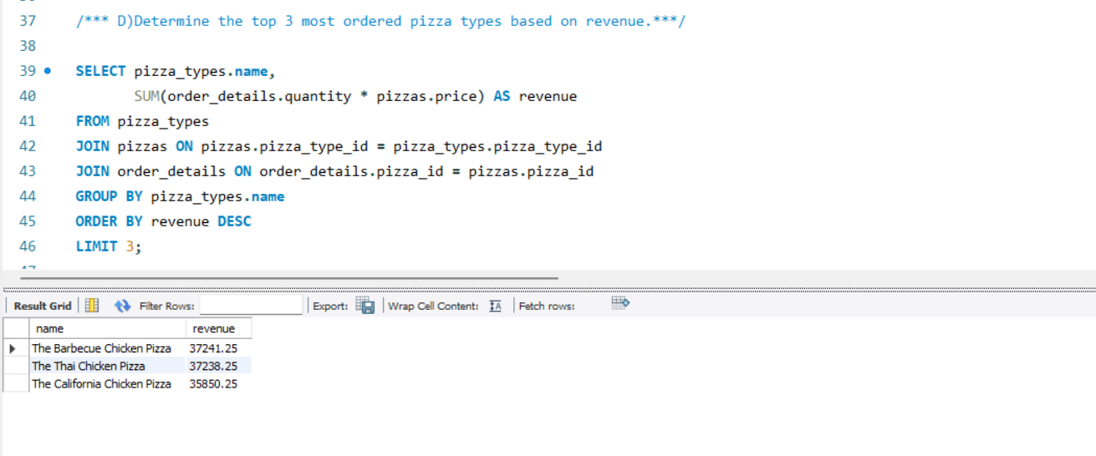
E. Determine the top 3 most ordered pizza types based on revenue.

